Slide 1
Gait Analysis with IMU’s
Dr Matthew Patterson
Biomedical Data Scientist
Shimmer Research
March 11, 2020

Slide 2
Motion Analysis
Motion analysis
Kinematics
Joint angles
Motion capture
Kinetics
Ground reaction force
Joint moments
Gait Analysis
Broken down into the gait cycle (initial contact – mid-stance – toe-off – swing phase)
Xsens is industry leader at joint angle estimation from wearable sensors (biomechanics / film industry applications)
Requires a sensor on each body segment (ie – sensor on the lower leg and the upper leg to get knee angle)
Step counting (easy to measure, easy to understand)

Slide 3
Motion Analysis with IMU Technology
 | Motion Analysis | Gait Analysis | Physical Activity | Steps | Sleep
Sensors | Accel Gyro Magnetometer | Accel Gyro (?) | Accel | Accel | Accel
Sensor Location | Every body segment that you a joint angle from | L3 Shank Foot Chest (Garmin) | Wrist L3 | Wrist L3 Shank Foot | Wrist
Metrics | Joint angle | Step time Stride time Ground contact time Step length | Sedentary Light PA Moderate PA Vigorous PA | Steps | Time in bed Sleep efficiency

Slide 4
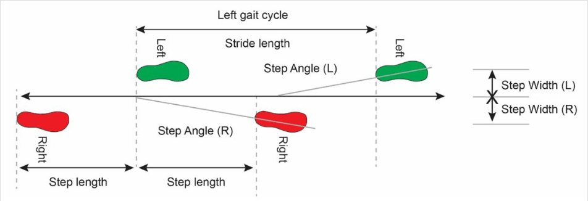
Gait Cycle: Stride vs Step

Slide 5
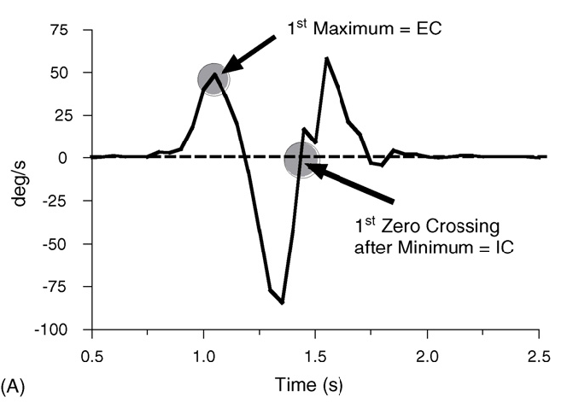
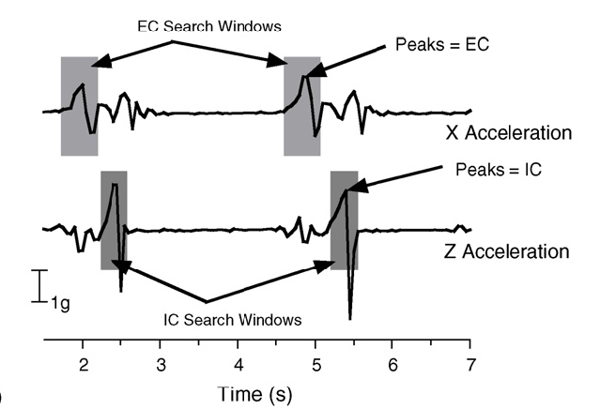
Traditional Heuristic Methods some more research recently on using ML methods

Slide 6
Digital End-Points in Clinical Trials
Gait analysis with wearable sensors
Digital end-points in clinical trials
Can we find end points using new technologies that reduce time of clinical trails?

Slide 7
Gait Analysis -
Foot – spatial / temporal gait parameters
Close to ground, so good IC/TO detection
Use zero velocity in stance to reduce integration time to get accurate velocity / distance parameters (step distance)
Sabatini, A.M., Martelloni, C., Scapellato, S. and Cavallo, F., 2005. Assessment of walking features from foot inertial sensing. IEEE Transactions on biomedical engineering, 52(3), pp.486-494.
Shank – temporal gait parameters
Investigated quantification of novel characteristics from IMU signal in relation to a gait characteristic that is associated with early onset knee osteoarthritis is ACL-reconstructed females
Patterson, M.R., Delahunt, E., Sweeney, K.T. and Caulfield, B., 2014. An ambulatory method of identifying anterior cruciate ligament reconstructed gait patterns. Sensors, 14(1), pp.887-899.
IC and TO are accurate, spatial parameters not as accurate
Greene, B.R., McGrath, D., O’Neill, R., O’Donovan, K.J., Burns, A. and Caulfield, B., 2010. An adaptive gyroscope-based algorithm for temporal gait analysis. Medical & biological engineering & computing, 48(12), pp.1251-1260.
L3 – Temporal gait parameters (TO is OK, can get spatial, but not accurate)

Slide 8
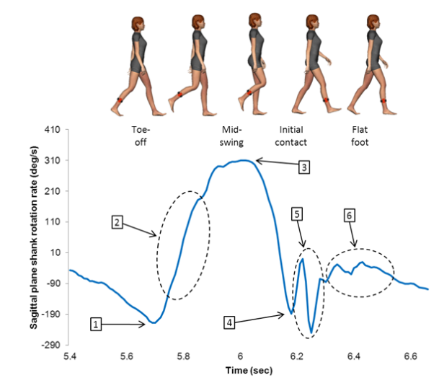
Novel Metrics from IMU’s
Investigate to see if novel metrics from IMU technology can be used to detect abnormal movement patterns
Lower knee adduction moment is associated with early onset knee osteoarthritis in ACL-reconstructed females, this was associated with a lower [3] value during gait trials

Slide 9
Wrist vs L3
Wrist
Activity / sedentary
Sleep
L3
Walking detection
Quality of mobility (temporal gait parameters)
Gait symmetry, gait variability

Slide 10
Supervised vs Unsupervised
Supervised
5m walking test, 6min walking test, Timed up and Go
Most clinical / academic research on gait has been for supervised tests
Comparable
Diagnosable
Unsupervised
Monitor patients as they go about their normal lives
Detect when walking occurs
Detect the gait metrics during walking periods
Context of gait period can cause large changes (ie – carrying groceries, walking with friends)
Little research done to develop standards
Not diagnosable
Difficult to get patients to wear sensors and wear them correctly
Get data from the real world

Slide 11
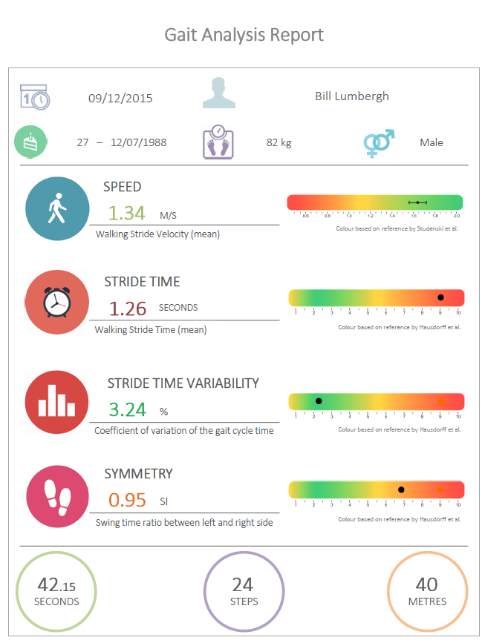
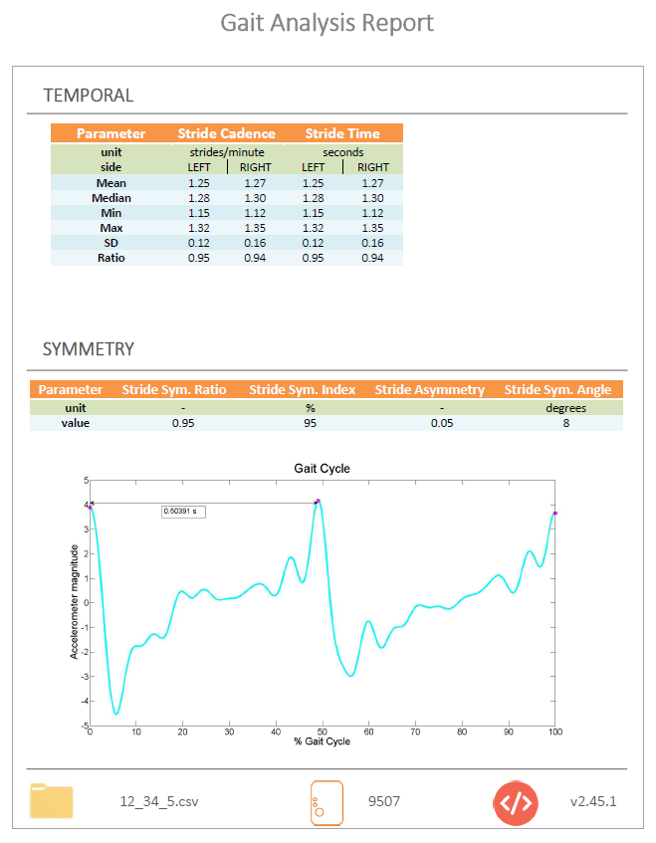

Slide 12
GaitPy
Open source Python library to analyze accelerometer data from L3

Slide 13
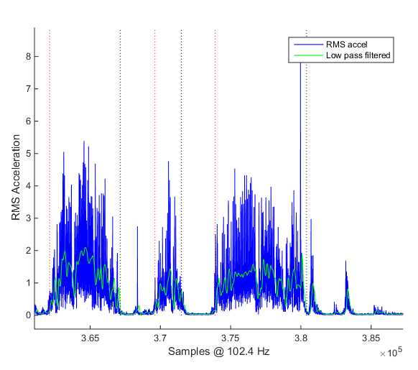
Detect Gait Periods
Consistent periods of activity are searched for to find steady state walking periods

Slide 14
Gait Period Variables
Category | Variable | Unit
gaitPeriods | start times | sec
 | end times | sec
 | start samples | sample
 | end samples | sample
 | gait period time | sec
 | average length | sec
 | max legnth | sec
 | std dev length | sec

Slide 15
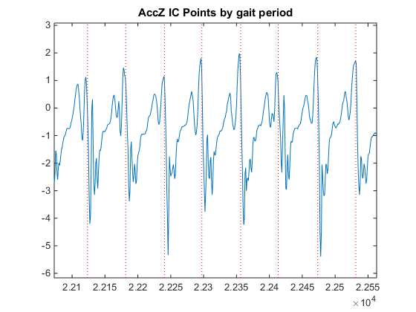
Initial Contact (IC) Identification
Based on Zijlstra & Hof, 2003
Anterior-posterior acceleration signal
‘..the peak forward acceleration preceding the change of sign (as determined by the zero-crossing method) is taken as the instant of foot contact’

Slide 16
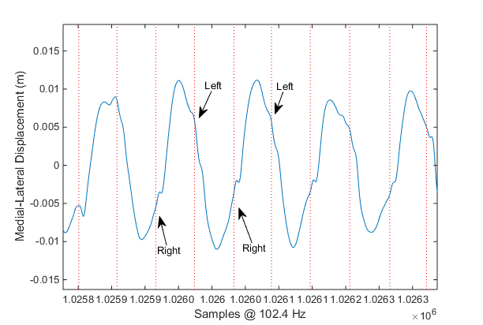
Left / Right IC Identification
Based on Zijlstra and Hof, 2003
Double integration of medial-lateral acceleration signal to obtain displacement
Positive going IC’s are right foot contacts, negative going IC’s are left foot contacts

Slide 17
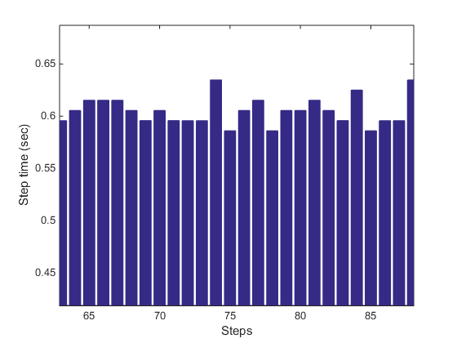
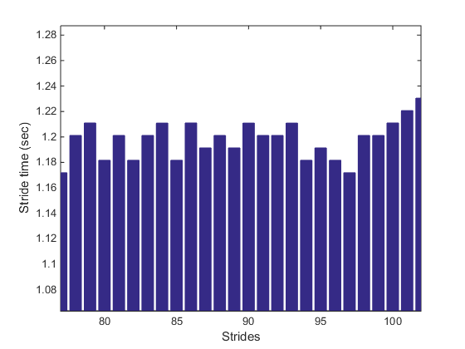
Step times / Stride times

Slide 18
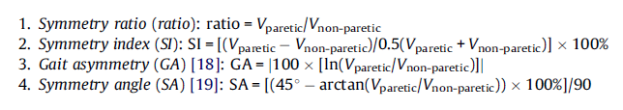
Gait Symmetry – Step & Stride
4 symmetry calculations based on the following work;
Patterson et al, 2010
Seadeghi et al, 2000
Plotnik et al, 2008
Zifchock et al, 2008

Slide 19
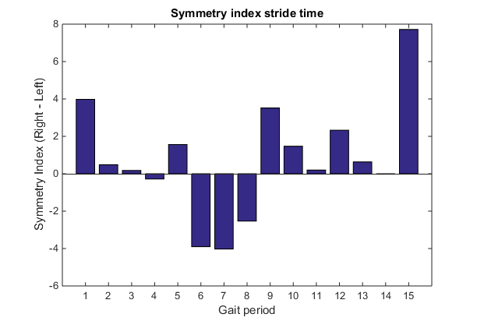
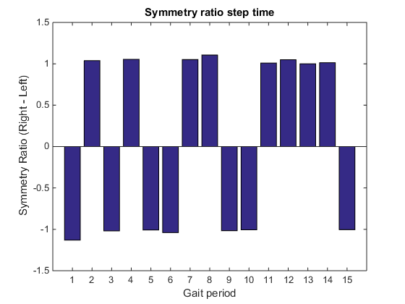
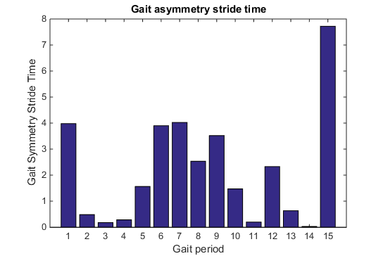
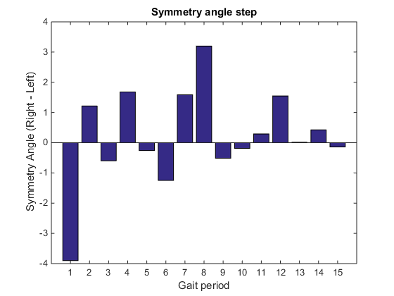

Slide 20
Temporal / Symmetry Variable List
Category | Variable | Unit
 | steps
 | right step time | sec
 | left step time | sec
 | step time | sec
 | right stride time | sec
 | left stride time | sec
 | stride time | sec
 | stride time variance | sec^2
 | step cadence | steps/min
 | stride cadence | strides/min
 | artefacts step time | number
 | artefacts stride time | number
 | symmetry ratio step
 | symmetry ratio stride
 | symmetry index step | %
 | symmetry index stride | %
 | gait asymmetry step
 | gait asymmetry stride
 | symmetry angle step
 | symmetry angle stride

Slide 21
Example data – Temporal Gait Parameters
Gait period | Length of each gait period (s) | Steps | Mean right step time (s) | Mean left step time (s) | Mean step time (s) | Mean right stride time (s) | Mean left stride time (s) | Mean stride time (s) | Stride time variance | Mean step cadence (steps/min) | Mean stride cadence
 | sec |  | sec | sec | sec | sec | sec | sec |  | steps/min | stride/min
1 | 32.56 | 19 | 0.783 | 0.811 | 0.797 | 1.688 | 1.685 | 1.686 | 0.0533 | 76.67 | 36.12
2 | 13.21 | 15 | 0.627 | 0.594 | 0.610 | 1.215 | 1.221 | 1.218 | 0.0054 | 98.73 | 49.42
3 | 49.24 | 55 | 0.614 | 0.628 | 0.621 | 1.258 | 1.260 | 1.259 | 0.0163 | 97.63 | 48.10
4 | 18.38 | 8 | 0.677 | 0.679 | 0.678 | 1.250 | 1.279 | 1.265 | 0.0095 | 90.05 | 47.59
5 | 63.58 | 65 | 0.662 | 0.684 | 0.673 | 1.373 | 1.352 | 1.362 | 0.0148 | 90.58 | 44.39
6 | 49.30 | 37 | 0.645 | 0.646 | 0.645 | 1.324 | 1.305 | 1.314 | 0.0177 | 94.35 | 46.07
7 | 100.20 | 98 | 0.631 | 0.622 | 0.626 | 1.252 | 1.261 | 1.256 | 0.0126 | 97.11 | 48.13
8 | 18.20 | 9 | 0.710 | 0.651 | 0.680 | 1.318 | 1.372 | 1.345 | 0.0069 | 88.75 | 44.70
9 | 451.31 | 729 | 0.596 | 0.589 | 0.592 | 1.188 | 1.186 | 1.187 | 0.0044 | 101.69 | 50.70

Slide 22
Example data – Temporal Gait Parameters

